Slide 1
Protection and Security

Slide 2
Goals of Protection
Process in OS must be protected from the one another.
Protection refers to a mechanism for controlling the access of the programs, processes or users to the resources defined by the computer system.
Protection improves reliability.
Protection Mechanism determine: how some thing will be done
Policy determine: what is to be done.
This mechanism must provide a means for specifying the controls to be imposed, together with a means of enforcement.

Slide 3
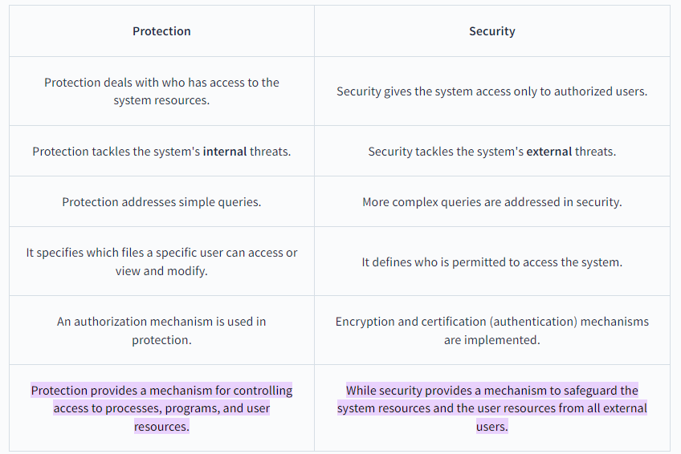
Difference b/w Protection and Security

Slide 4
Access Control
Method that determines:
  What types of access are permitted on different resources
  Under what circumstances
  By Whom

Slide 5
Access Control
Access Control Model has 3 basic components:
  Subjects (S) or Domain: Represents a finite set of entities that have access to current object.
    Subject may be: User , Process or Procedure
  Objects (O): Represents a finite set of resources that need access.
    Object may be: H/w device ( processor, memory) Or S/W resources ( page table, files etc)
  Rights ( R): Represents a finite set of Operations that a Subject can perform on Object.

Slide 6
Access Control Policies
Protection Domain: is a collection of objects and access rights (Permissions –rwx-)
Access Control
  In this model, Each object is owned by some subject/domain and Owner of the object decides which/ what kind of access rights are there.
Mandatory Access Control
  System Administrator enforce a policy for all users.
Role-Based Access Control
  Access control is based on roles that users have within the system

Slide 7
Discretionary Access Control/ Access Matrix
Discretionary Access Control Model is represented by Access Matrix.
It is used to describe which users have access to what objects or resources.
Access Matrix consists of Rows and Columns
Rows represent : Current Subject / Domain
Column represent: Current Object

Slide 8

Access Matrix

Slide 9
Use of Access Matrix
If a process in Domain D_{i} tries to do “op” on object O_{j}, then “op” must be in the access matrix
Can be expanded to dynamic protection
  Operations to add, delete access rights
  Special access rights:
    owner of O_{i}
    copy op from O_{i} to O_{j}
    control – D_{i} can modify D_{j} access rights
    transfer – switch from domain D_{i} to D_{j}

Slide 10
Implementation of Access Matrix
There are 2 methods:
1. Access Control Lists
  ACL can be created by dividing Access Matrix Column Wise.
  Separate list is maintained for each domain and each object.
  It skips blank row entries in each domain.
2. Capability List
  Can be created by dividing Access Matrix Row Wise.
  It is list of access rights that a user / domain or a process has for a object.
  It is divided into 2 fields:
    Object Descriptor
    Access Rights

Slide 11
Operation on Access Matrix Entries
1. Copy
  It allows the access right to be copied only within the column (for an object)
  A process executing in domain D2 can copy read operation into any entry associated with file F2
  The ability to copy rights is denoted by an asterisk, indicating that processes in that domain have the right to copy that access within the same column

Slide 12
Operation on Access Matrix Entries
2. Owner
  It allows addition or removal of access rights.
  If any access includes owner right then a process executing in domain Di can add or remove any access right in entry of that column.
Copy and Owner allow a process to change the entry in column.

Slide 13
Operation on Access Matrix Entries
3. Control Right
  Control right mechanism used to change entries in a row.
  Control right is applicable only to domain objects.
  If access( i , j ) includes control right, then a process executing in domain Di can remove any access right from row j.

Slide 14
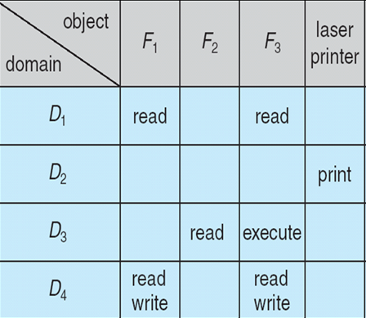
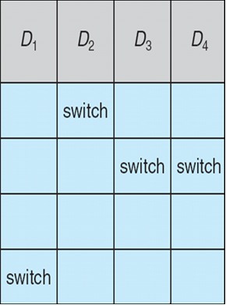
Access Matrix With Domains as Objects
Figure B

Slide 15
Security
Method of protecting information stored in the system from un-authorized access.
Security must consider external environment of the system, and protect it from:
  unauthorized access.
  malicious modification or destruction
  accidental introduction of inconsistency.
Security violation can be categorized as intentional or accidental.
Security is a measure of confidence that the integrity of a system and its data will be preserved.

Slide 16
Some Security Violations
Breach of Confidentiality: Unauthorized reading of data. Theft of information
Breach of integrity: Unauthorized modification of data.
Breach of availability: Unauthorized destruction of data/ website defacement:
A website defacement is an attack on a website that changes the visual appearance of the site or a webpage.
Theft of service: Unauthorized use of resources.
Denial of service: Send invalid data to applications or network services, which cause abnormal termination.
Flood a computer or the entire network with traffic until a shutdown occurs because of the overload.

Slide 17
Security Measure Levels
To protect our system, we must take security measures at 4 levels:
Physical - Secure Hardware Components
Human – Use Passwords for protection
Operating system – Use Valid Login and Password
Network – Use authentication and anti-virus to protect data/ resources over the network.

Slide 18
Program Threats
Writing a program that creates a breach of security or causing a normal process to change its behavior and create a breach is the common goal of crackers
Malware: A destructive program that pretend to be a gentle application.
A back door is a means of access to a computer program that bypasses security mechanisms.

Slide 19
Program Threats
1. Trojan horse
A Trojan horse, or Trojan, is software that appears to perform a desirable function for the user, but steals information or harms the system.
Trojan horse is a program in which harmful code is contained in such a way that it can get control and do its chosen form of damage

Slide 20
2. Spyware
A software that secretly monitors the user's computing.
Spyware is a type of malware that can be installed on computers, and which collects small pieces of information about users without their knowledge.
The presence of spyware is typically hidden from the user, and can be difficult to detect.
Sometimes, Spywares are installed by the owner of a shared, corporate, or public computer in order to secretly monitor other users.

Slide 21
3. Trap Door
The designer of a program or system might leave a hole in the software that only designer is capable of using. This type of security breach is called trap door.

Slide 22
4. Logic Bomb
Under normal operations, there would be no security hole. However, when a predefined set of parameters was met, the security hole would be created. This scenario is known as a logic bomb.

Slide 23
5. Stack and Buffer Overflow
The stack- or buffer-overflow attack is the most common way for an attacker outside the system, on a network or dial-up connection, to gain unauthorized access to the target system.

Slide 24
6. VIRUS
Fragment of malicious code embedded in a genuine program.
designed to “infect” other programs.
Specific to architecture, operating systems and applications.
Needs human intervention to move from host to host.
Needs some one to actually take that program from one device and run it onto other device
Does not self replicate itself

Slide 25
System and Network Threats
Program threats typically use a breakdown in the protection mechanisms of a system to attack programs.
System and network threats involve the abuse of services and network connections.
System and network threats create a situation in which operating-system resources and user files are misused.

Slide 26
Authentication
Process of verifying the identity of user or information
1. User Authentication
  Process of verifying the identity of user when user logs into a computer system.
  Main Objective: Allow authorized users to access the computer.
  Authentication Process consists of 2 steps:
  Identification Step
  Verification Step

Slide 27
Measures of Authentication
False Acceptance Ratio: % of unauthorized users incorrectly entered the system
False Rejection Ratio: % of authorized users that fails to access the system due to failure of authentication.

Slide 28
General Methods of Authentication
Include a Password
Include electronic key or smart cards
Static Biometric – Recognition by finger print, retina or face.
Dynamic Biometric – Recognition by Voice, Handwriting or Typing Pattern.

